Slide 1
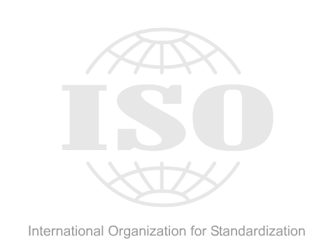
CHAPTER - 2
Network Models
Part-2

Slide 2
TCP/IP protocol

Slide 3


Cont.
Made up of 2 complementary protocols…
TCP/IP
Transport Control Protocol
Internet Protocol

Slide 4
TCP Protocol
Breaks files into packets to be sent across the internet or a network. Each packet contains:
  The address of the sender.
  The destination address.
  Error-detecting checksum.
  A chunk of data (e.g. 1K).

Slide 5
IP Protocol
Once a file has been chopped into packets, the IP protocol delivers each packet to its destination.
Each packet can take a different route from A to B, bouncing from router to router getting more precise with each hop.
The route is dynamically chosen for each packet, based on internet conditions at that time.

Slide 6
Cont.
TCP again…
  At the packets’ destination the receiving computer’s TCP re-assembles packets back into the original file.
  Recalculates checksum to see if packet is OK.
  If packets are damaged, lost or delayed in transmit, TCP will request the server to send the packet again.

Slide 7
2.4 TCP/IP protocol suite
The layers in the TCP/IP protocol suite do not exactly match those in the OSI model.
The original TCP/IP protocol suite was defined as having four layers:
(1). Host-to-network (2). Internet (3). Transport (4). Application.
However, when TCP/IP is compared to OSI, we can say that the TCP/IP protocol suite is made of five layers:
(1). Physical (2). Data link (3). Network (4). Transport (5). Application.

Slide 8






Comparison with TCP/IP
OSI Model | TCP/IP Model
Application Layer
Presentation Layer
Application Layer
Session Layer
Transport Layer
Transport Layer
Network Layer
Internet Layer
Data Link Layer
Host-to-Network
Physical Layer

Slide 9

Cont.
Figure 2.16 TCP/IP and OSI model

Slide 10
Physical and Data Link Layers
At the physical and data link layers, TCP/IP does not define any specific protocol. It supports all the standard and proprietary protocols. A network in a TCP/IP internetwork can be a Local-Area Network (LAN) or a Wide-Area Network (WAN).

Slide 11
Network Layer
At the network layer (or, more accurately, the internetwork layer), TCP/IP supports the Internetworking Protocol. IP, in turn, uses four supporting protocols: ARP, RARP, ICMP, and IGMP. Each of these protocols is described in greater detail in later chapters.

Slide 12
Transport Layer
Traditionally the transport layer was represented in TCP/IP by two protocols: TCP and UDP.
IP is a host-to-host protocol, meaning that it can deliver a packet from one physical device to another.
UDP and TCP are transport level protocols responsible for delivery of a message from a process (running program) to another process. A new transport layer protocol, SCTP, has been devised to meet the needs of some newer applications.

Slide 13
Application Layer
The application layer in TCP/IP is equivalent to the combined session, presentation, and application layers in the OSI model. Many protocols are defined at this layer. We cover many of the standard protocols in later chapters.

Slide 14

2.5 Addressing
Four levels of addresses are used in an internet employing the TCP/IP protocols: Physical (link) addresses, Logical (IP) addresses, Port addresses, and Specific addresses.
Figure 2.17 Addresses in TCP/IP

Slide 15

Cont.
Figure 2.18 Relationship of layers and addresses in TCP/IP

Slide 16
Physical Addresses
The physical address (or MAC), also known as the link address, is the address of a node as defined by its LAN or WAN.
The size and format of these addresses vary depending on the network.
  For example, Ethernet uses a 6-byte (48-bit) physical address that is imprinted on the network interface card (NIC).

Slide 17
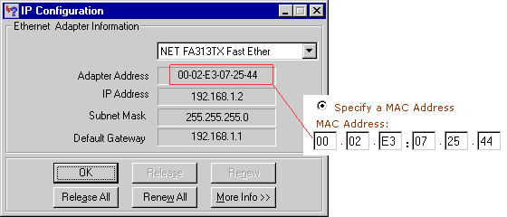
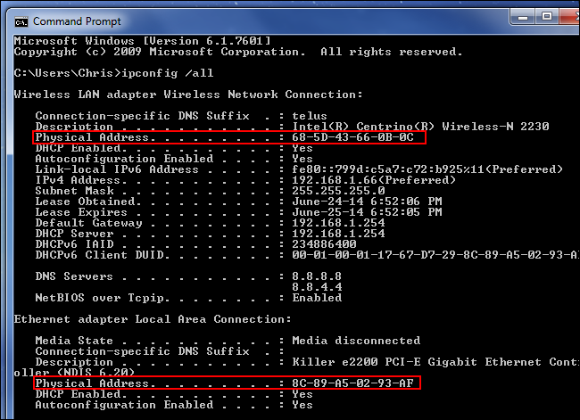
Physical Addresses

Slide 18
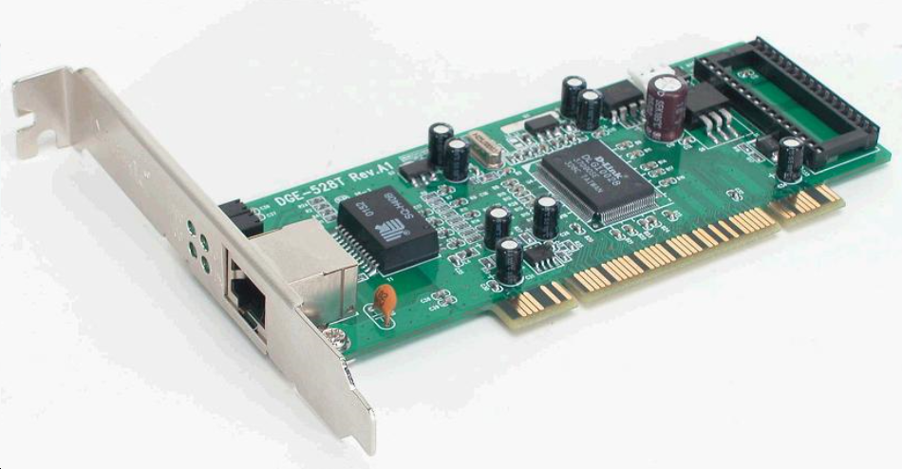
Network Interface Card (NIC)
To connect to a network, a computer uses a network interface card (NIC). A NIC controls the wired and wireless connections of a computer to exchange information with other computers and the Internet. A network interface card is also known as a network interface controller, network adapter, or Local Area Network (LAN) adapter.

Slide 19

Example 2.1
In Figure 2.19 a node with physical address 10 sends a frame to a node with physical address 87. The two nodes are connected by a link (bus topology LAN). As the figure shows, the computer with physical address 10 is the sender, and the computer with physical address 87 is the receiver.
Figure 2.19 Physical addresses

Slide 20
Logical Addresses
Logical addresses are necessary for universal communications that are independent of underlying physical networks.
Physical addresses are not adequate in an internetwork environment where different networks can have different address formats.
A universal addressing system is needed in which each host can be identified uniquely, regardless of the underlying physical network.
  The logical addresses are designed for this purpose.
A logical address in the Internet is currently a 32-bit address that can uniquely define a host connected to the Internet.
No two publicly addressed and visible hosts on the Internet can have the same IP address.

Slide 21
Port Addresses
The IP address and the physical address are necessary for a quantity of data to travel from a source to the destination host.
However, arrival at the destination host is not the final objective of data communications on the internet.
Today, computers are devices that can run multiple processes at the same time. The end objective of internet communication is a process communicating with another process.

Slide 22
Cont.
For example, computer A can communicate with computer C by using TELNET. At the same time, computer A communicates with computer B by using the File Transfer Protocol (FTP). For these processes to receive data simultaneously, we need a method to label the different processes. In other words, they need addresses. In the TCP/IP architecture, the label assigned to a process is called a port address. A port address in TCP/IP is 16 bits in length.

Slide 23

Cont.
Note
The physical addresses will change from hop to hop,
but the logical and port addresses usually remain the same.

Slide 24
Specific Addresses
Some applications have user-friendly addresses that are designed for that specific address.
  Examples include the e-mail address (for example, aslam@nstu.edu.bd) and the Universal Resource Locator (URL) (for example, https://nstu.edu.bd).

Slide 25
Differences between OSI & TCP/IP
H. W

Slide 26

K. M. Aslam Uddin
Assistant Professor (ICE)
Noakhali Science and Technology University

